Slide 1
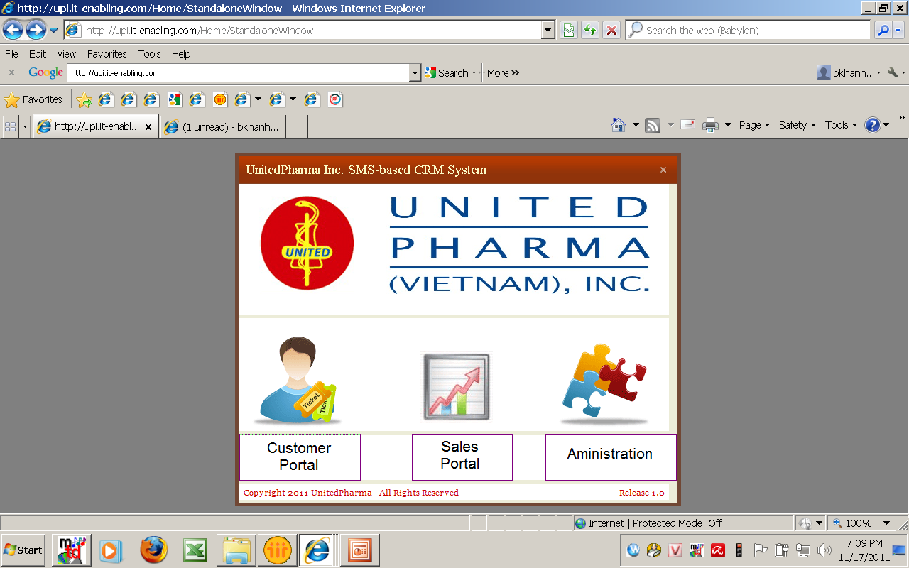

Slide 2
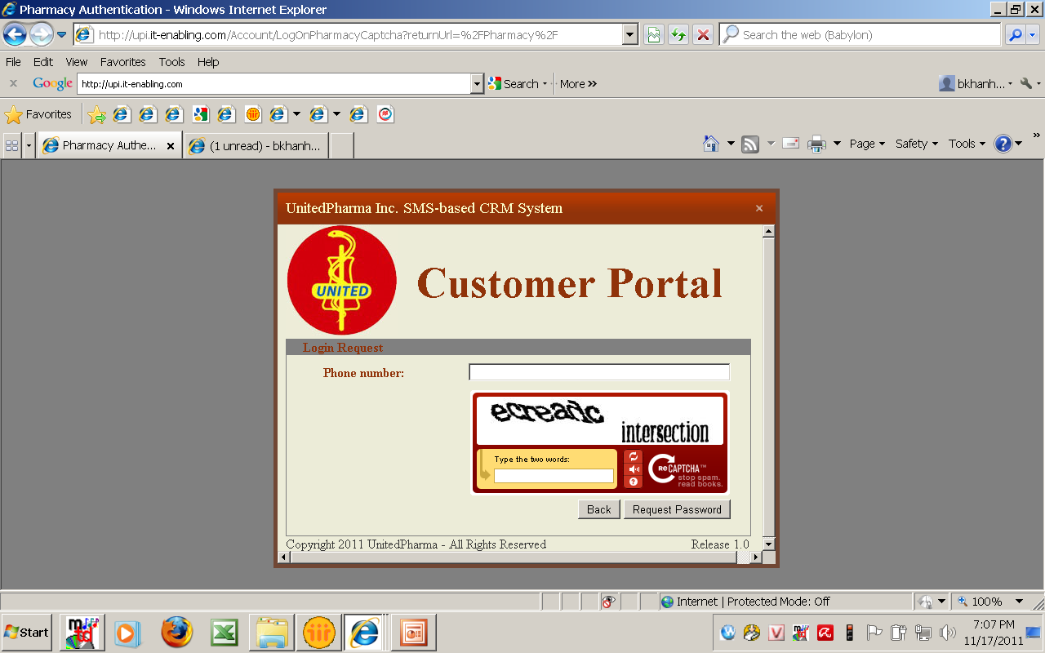
I still cannot log in by Customer icon

Slide 3
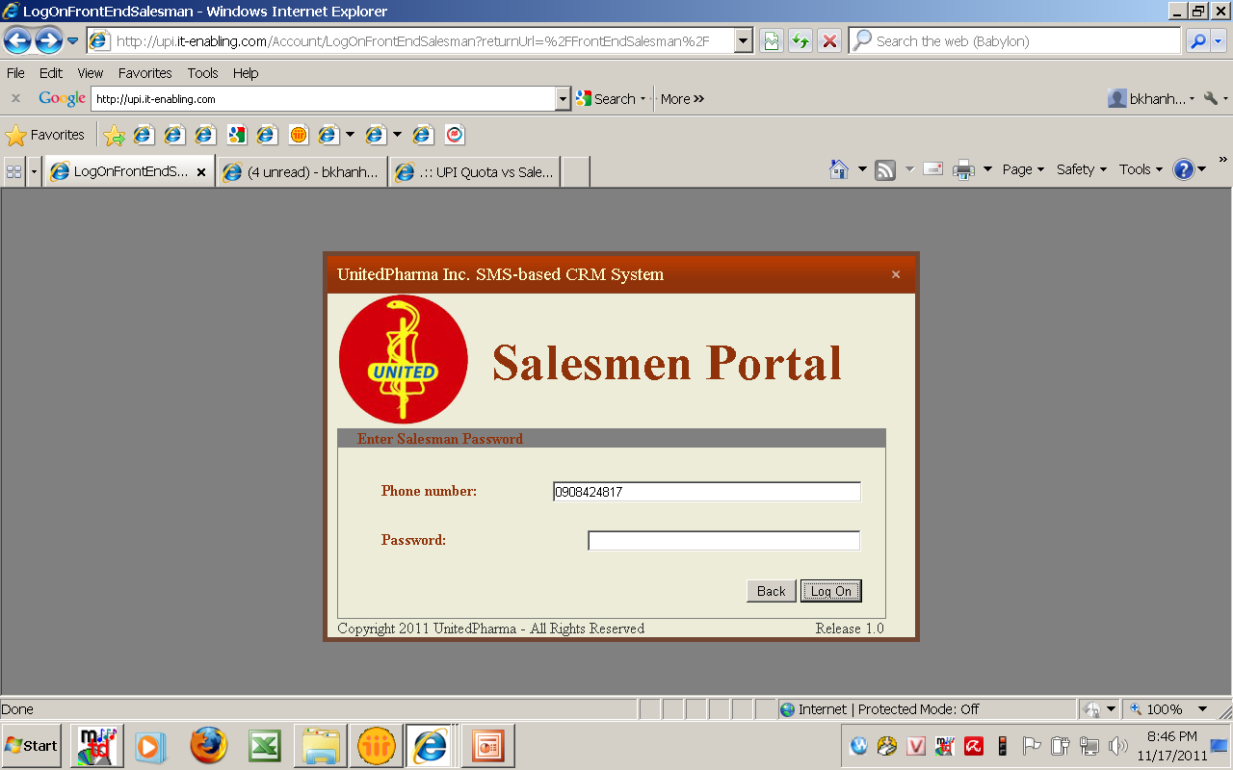
Log in by ROM account
Notes:
Sau khi vao he thong , sau mot thoi gian bi rot ra khoi account.-→ it is ok
Nhung nen co mot cua so thong bao la tai khoan da su dung hon bao nhieu phut roi , va con khoang 5 phut nua la tu dong rot ra khoi tai khoan va nguoi sd phai save viec ho dang lam va vo lai sau.
Vi nhieu khi ho dang edit thi bi rot ra , khong hay lam

Slide 4
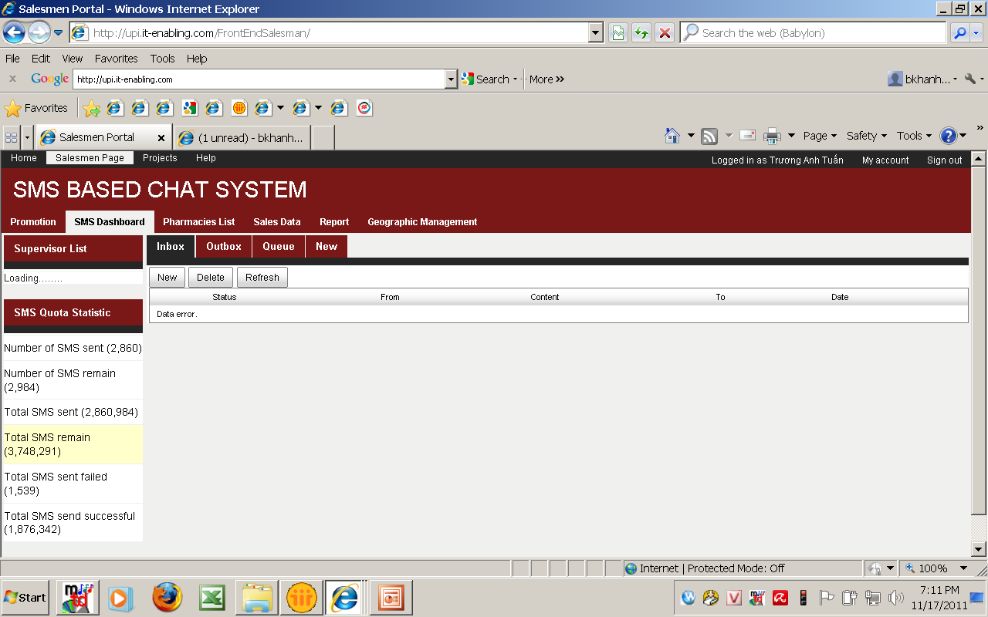
Notes:
Data error ?? What can we see here ?
SMS Quota Statistic : thong ke nay la sao ?
So tong cong ma ROM nay da gui hay la ca team cua anh ta gui? Hay la da nhan? Vi khanh thay day la inbox nen nghi la tin da nhan.
Vay thi phan inbox khong can phai thong ke nay ma can thong tin la tin nhan nhan duoc do co duoc tra loi hay chua , hoac la xu ly hay chua ? Tien trinh cua no toi dau roi, da ket thuc chua ? Va nguoi ta phan ung lai ve tin nhan nao cua minh da gui ?– cai nay thi hong biet la co track duoc khong? Nhung minh muon biet la nguoi nhan phan ung ve tin nhan cua minh hay la van de moi, minh nen co mot box de xep loai thu den.
Muc tieu la minh co the thong ke cac van de vao cuoi mot thang hoac mot quy thi da nay moi co tac dung cho hd Mkt va sale

Slide 5
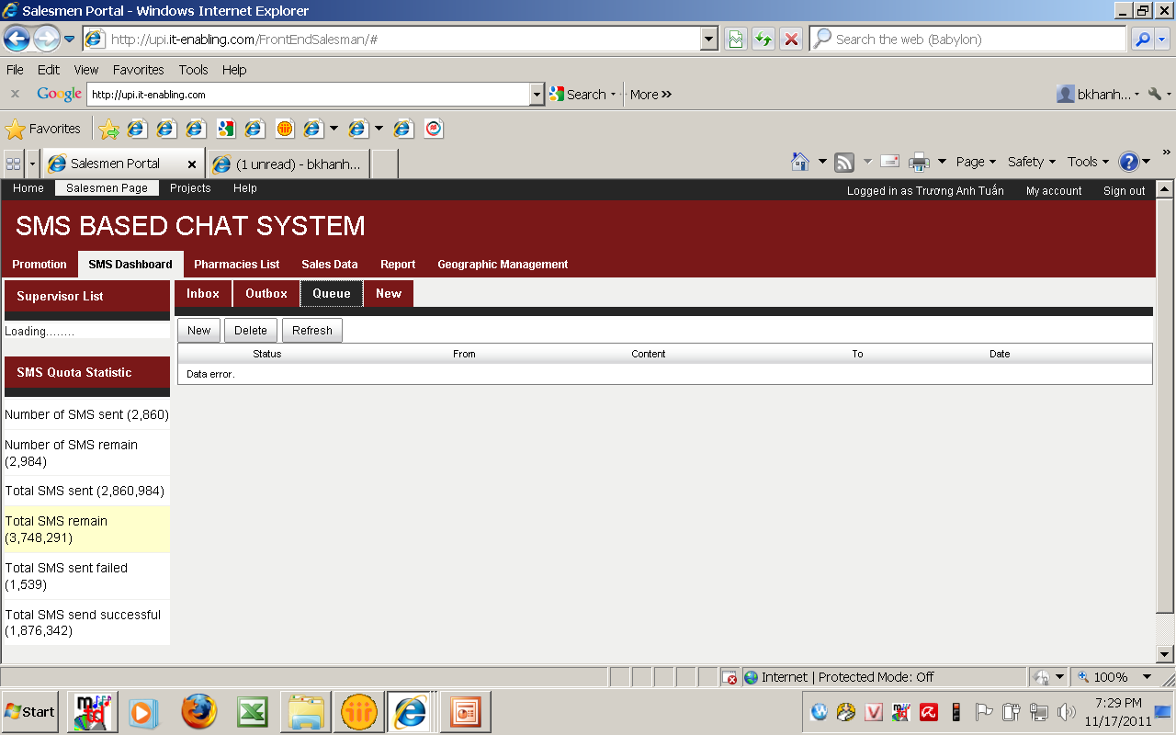
Notes:
Out box va Queue van chua hien thi duoc gi .
Nhung ve giao dien cua out box , Khanh muon biet them: ( ben canh nhung thong tin hien co)
Va can co mot dong subject ( chu khong phai la content) va cong cu de tim kiem, vi nhieu luc minh can phai truy lai thi lam sao ? Neu muon biet content thi co the click vao de doc.
Tin nhan da gui nay duoc chuyen cho bao nhieu nguoi, fail bao nhieu nguoi, con remain bao nhieu nguoi?
Neu fail thi no co tu dong gui lai khong ? Ma minh co biet duoc la cai nao fail khong?
phan tin tu dong gui lai do bi fail nay co bi tinh phi khong?
Va o ben giao dien cua Admin thi Khanh muon biet duoc, tin nhan trong out box la tu ai gui, va nguoi do da gui bao nhieu tin trong ngay roi, con co the gui bao nhieu tin nua ?
Con Queue thi se hien thi gi ?? Khanh khong nho

Slide 6
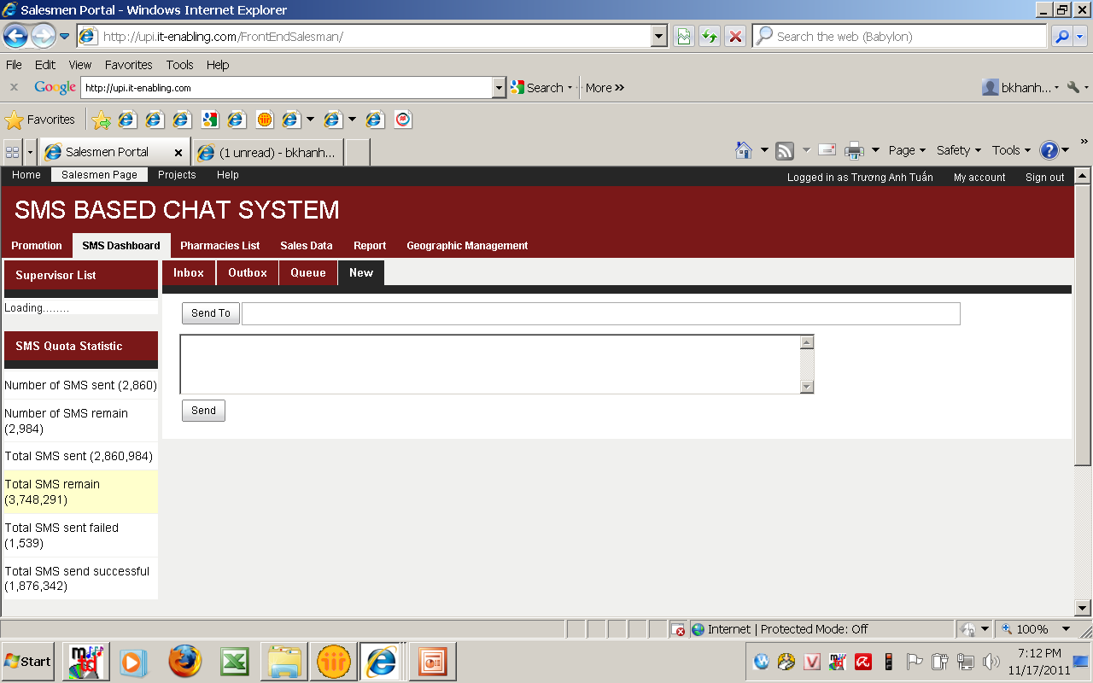
Notes:
Khanh muon biet la ky tu cua tin nhan dang con co the danh la bao nhieu ?
Va no nen co mot dong subject de dang truy tim neu can

Slide 7

Notes:
OK- Khanh khong muon ai co quyen gui tin den so dien thoai khong co ten trong danh sach.
Nhung quyen Admin co the tao ra mot danh sach tam thoi de giu tin nhan voi mot so yeu cau thong tin co ban
Nhu la ten, so, bo phan, nguoi chiu trach nhiem, ghi chu

Slide 8
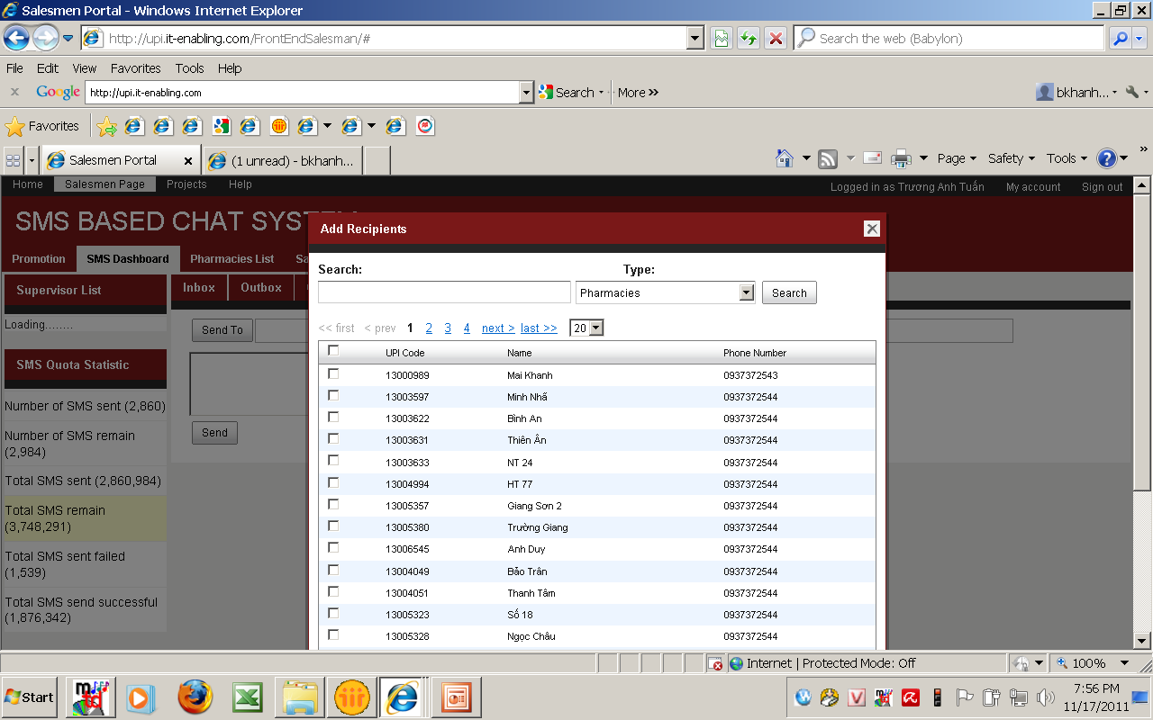
Notes:
Ngoai ra danh sach de sent to, Khanh can co mot lua chon ben canh : search, type, nhom khach hang theo loai hinh kinh doanh, theo vung. Code co the dung de search nhung Khanh khong can nhin thay upi khi lua chon khach hang de gui tin dau.
Khi gui tin nhan , can biet la khach hang do la thuoc nhom khach hang nao( si , le) ? Do ai quan ly ( thuoc Sup nao ? Rep nao ? ) va thuoc vung nao ?
Khanh chup mot so lua chon tuong tu nhu trong giao dien ma Khanh dang lam viec tren portal

Slide 9
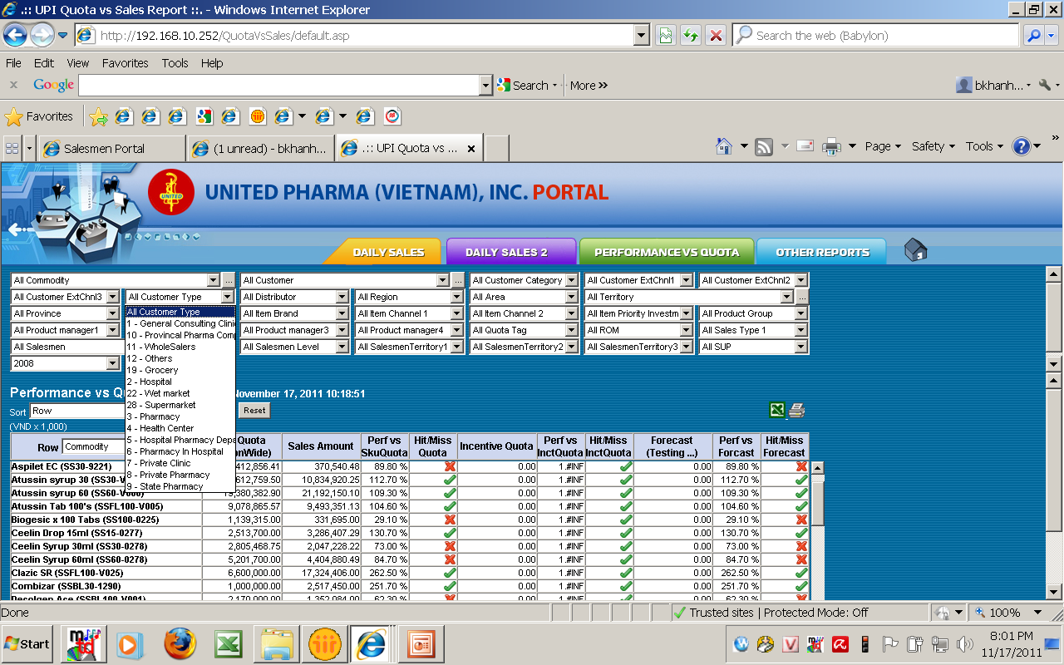
Notes:
Theo phan loai khach hang

Slide 10
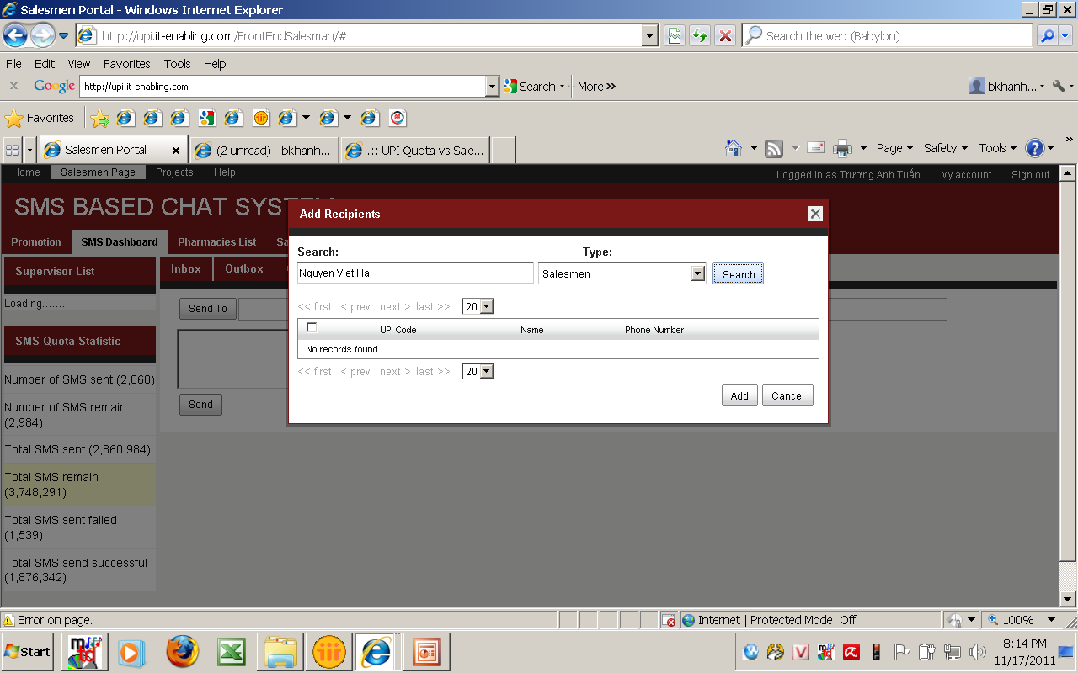
Notes:
Ngoai ra, sap xep tren list danh sach nay la theo chu cai cua ten de con tim nua
Vi nhieu khi cong cu search khong tim thay nhu truong hop nay. Chi nay co ten trong danh sach ma.

Slide 11
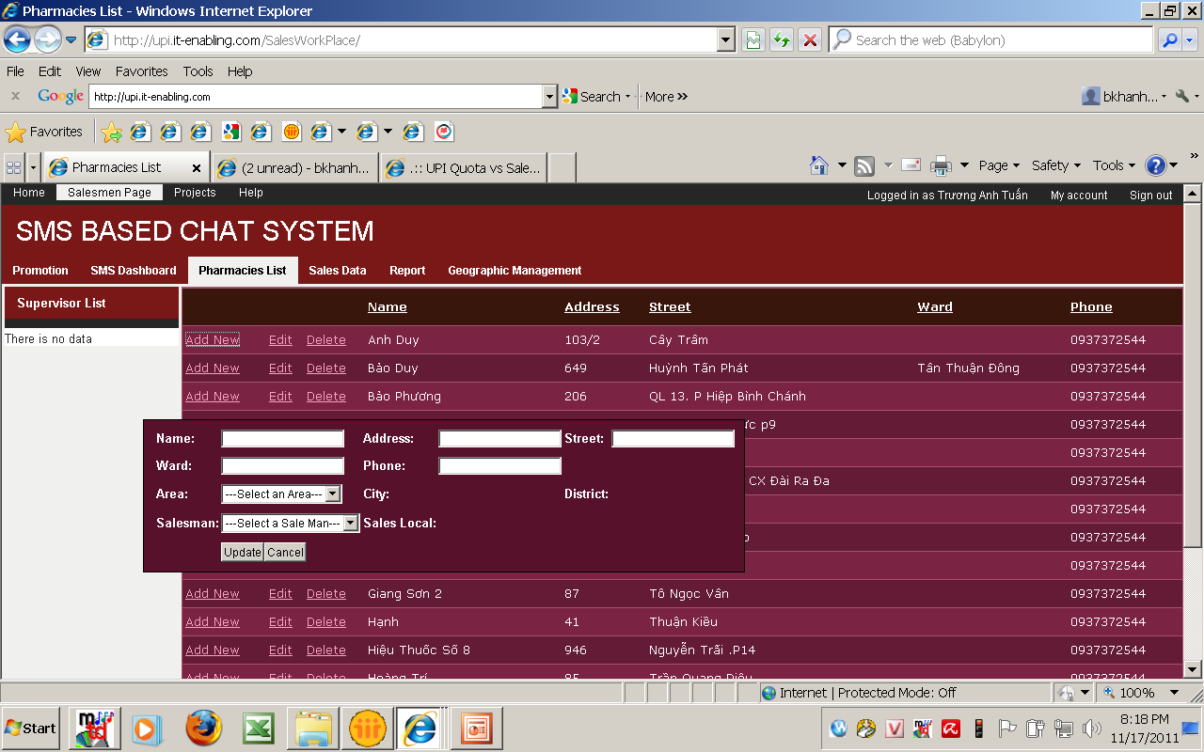
Notes:
Nhu da thao luan thi nguoi su dung ( ROM) khong duoc add new or Delete account khach hang , moi thong tin moi ve khach hang va sale man se nhap du lieu tu masterlist cua anh cuong. No se duoc update mot thang mot lan vao ngay giua thang.Vi no anh huong den su quan ly account khach hang cua toan he thong cong ty.
=➔ tren phan quyen cua Admin thi co mot cong cu de import data tu du lieu cua master list ma cung gioi han so luong lam viec nay

Slide 12

Notes:
Quyen Edit thimoi nguoi tu saleman den Admin co the lam duoc nhung he thong co the export data ra va co luu lai du lieu truoc khi edit.
“ Name” --- pharmacy / company name, de khong nham lan ten cua so dien thoai.
Trong cua so mo ra : ngoai nhung thong tin hien nay, Khanh muon co mot so thong tin khac nhu la:
Canh ben box “phone” Khanh muon biet la chu nhan cua so dien thoai do la ai, ho la saleclerk, owner, Manager, Doctor, Orther; va ten cua chu nhan so dien thoai, loai nha thuoc (a, b, c, d...)(may thong tin nay cac anh sale se them vao sau)
Va tinh trang cua nha thuoc ( active or close), ngay update.

Slide 13
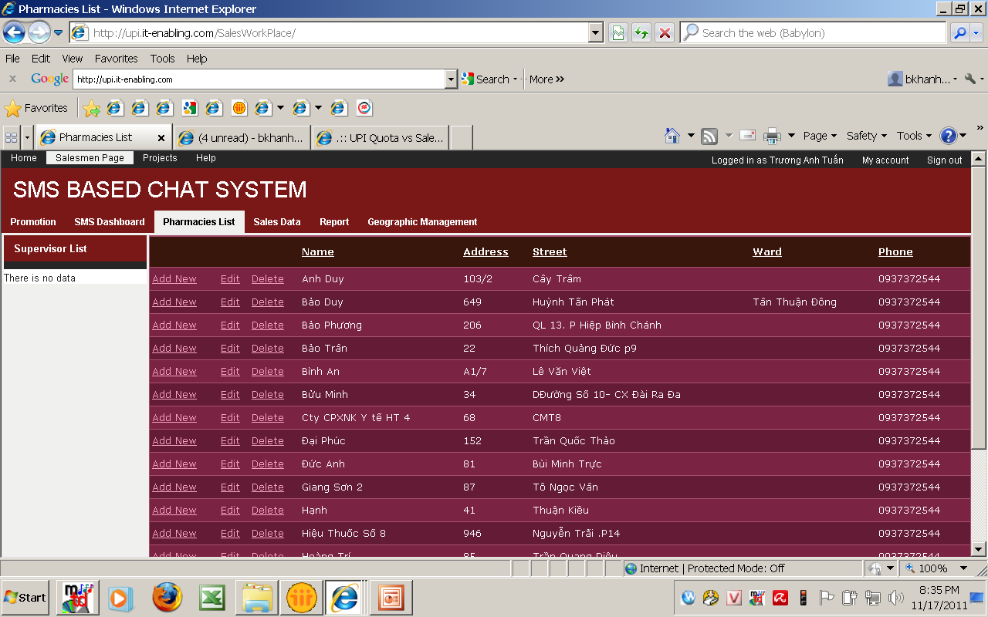
Cac item khac nhu Sale data, report,... , van chua vao duoc khi click vao
Notes:
Tren giao dien nay, Khanh muon biet nha thuoc do thuoc ve dang khach hang nao (si/ le/ bacsi ..) nhu masterlist va giai thich tren), thuoc ai quan ly, vung nao, ten nha thuoc, so dien thoai, ten cua chu so dt, co duoc update chua( stick mark only) . Cac chi tiet ve dia chi nhu so nha, duong, quan chi nhin thay khi minh click vao ten nha thuoc do thoi.

Slide 14
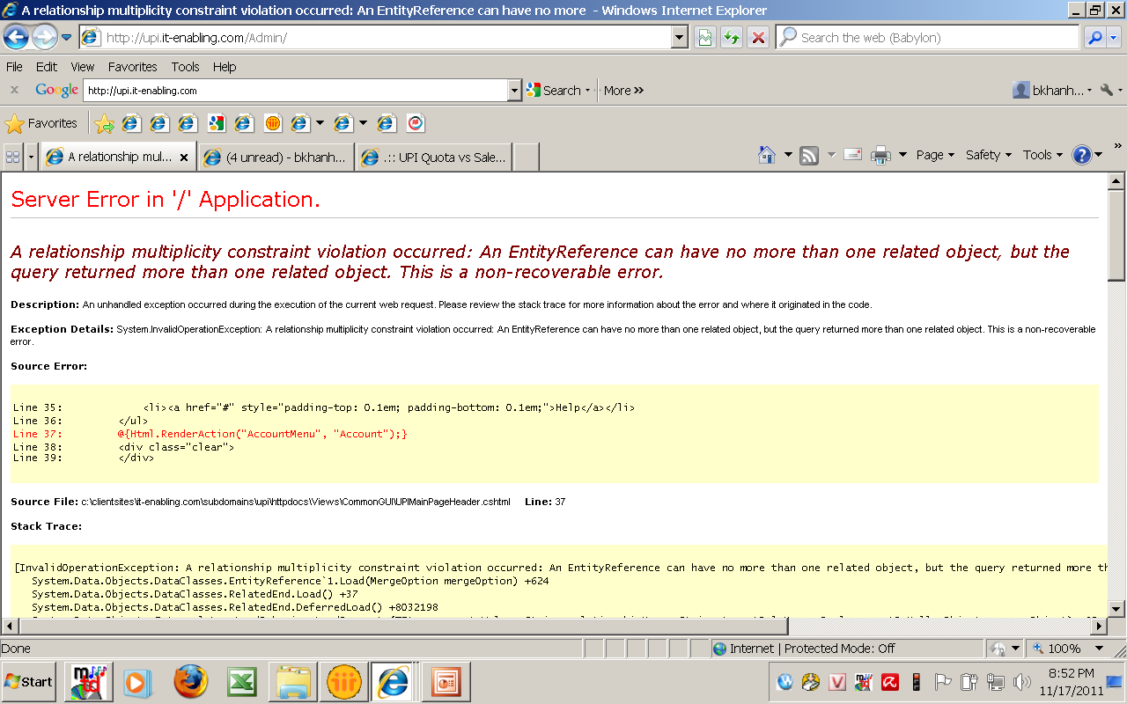
Account admin khong the vao duoc ?

Slide 15
Sorry vi may Khanh khong danh tieng viet duoc nen may ban phai vua doc vua doan.
Goi cho Khanh neu ma chua hieu ro
Vui long tien hanh lam khan cap giup Khanh.
Cam on rat nhieu!!

